Slide 1
IT166 Python for Data Science & Data Analytics I/O Files in Python
The goal of this class is to turn data into information, and information into insight that leads to do informed decisions.

Slide 2
Objectives
Create a file object from a local text file
Read the file information
Write something to the file

Slide 3
Files
Two ways to create a file object (open a file) in Python:
f = open(“Path_to_file”,”mode”)
with open((“Path_to_file”,”mode”) as f:
Option 1 requires to close the file manually: f.close()
If mode is ignored, it is open for reading.
Modes:
“r”—reading
“w”– writing from the beginning of the file (old content will be deleted)
“x”– writing from the beginning if the file is not existed
“a”—writing but appending (old content will be kept)

Slide 4
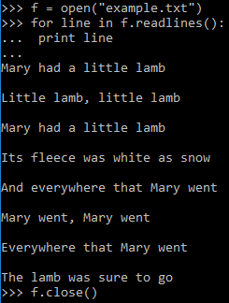
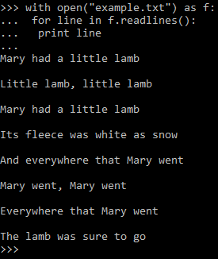
Example
Every single line in the file is a string
Try to write the first line as a string

Slide 5
readline() and readlines()
The readline method reads one line at a time, while the readlines read the entire file and returns a list of strings, each of which is a line in the file.

Slide 6
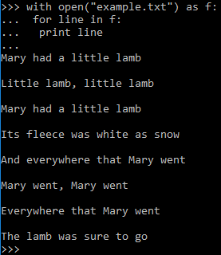
The file iteration protocol
However, there is a way to loop through a file without using any of the method. It is considered as a better approach in terms of memory management by taking advantage of the file iteration protocol.

Slide 7

Remove the newline string

Slide 8

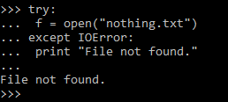
The try-except statements
Similar to Java’ try-catch block, Python has try-except statements to handle errors.

Slide 9
Practice on a concrete example
Download the netflix_ratings.csv file from ReggieNet and have the file saved in your local folder and browse the file a little bit.
Within the same folder, create a .py or a .ipynb file.
Create a file object by opening the csv file for reading.
Import the csv module (import csv) and call the reader method of the module to create a csvreader object: csv.reader(csvfile, delimiter=",")
csvreader now is a iterable object.
Create a dictionary named info that keys are the ratings, values are lists of tuples: {“R”:[(Lucky Number Slevin, 2006),….],…..}
Count the number of movies rated R since the year of 2000.
Apply try and Exception for application development best practices.

Slide 10
Questions

